Slide 1
Views

Slide 2
View
A virtual table that represents the data in one or more tables in an alternative way
NO physical existence in database
It contains data at run time only
It can be used to
Select
Insert
Update
Delete data from the tables

Slide 3
Views Continued….
By using View we can join multiple tables and present the data as coming from a single table
It is used for security purposes i.e. when you want to hide the actual tables or column of tables participating in the query
View can be used in other Views and Stored Procedures
View does not accept any parameter
View cannot use Stored Procedure in it

Slide 4

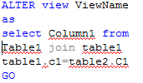
Operations
Call
Alter
Create
Can Only select query in body
Drop

Slide 5
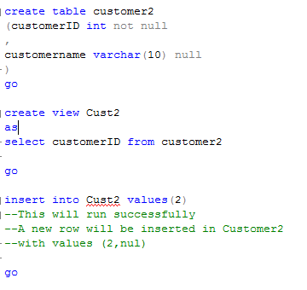
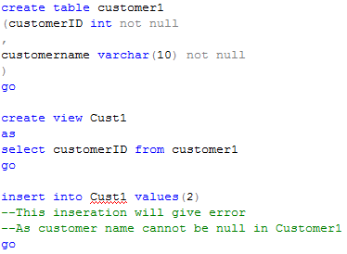
Insert Data Through View
The data will be inserted in tables from which view is created
Data will only be inserted if not constraints on underlying tables in violated

Slide 6
Delete and Update through View
Delete and update work similarly a Insert
If Deletion and Update does not violate and constraints on underlying table

Slide 7
Views WITH CHECK Option
To restrict the changes that users can make
Use the CREATE VIEW command’s WITH CHECK OPTION clause when defining the view
Note that any data can be added directly in the tables, but not through view

Slide 8

Views WITH CHECK Option Example
Create a view withCheck Option
Adding any data via this view that does not fulfill where clause will not be inserted
-->>This will not be inserted
-->>This will be inserted Correctly

